Slide 1
UMAC HACKATHON
Team 8 – SmartUmac
Ricardo Brito
Manuel da Veiga

Slide 2
Problem #1
UM News and Events app
UM holds many different events in campus
Sometimes many News and Events go unnoticed due to the lack of a platform to advertise them
So I decided to target Problem #1
3 APIs: UM News, UM Events and Public Holidays

Slide 3
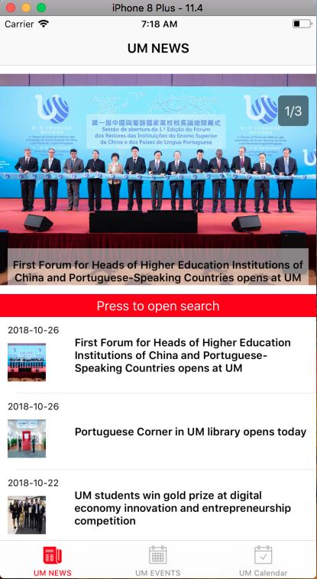

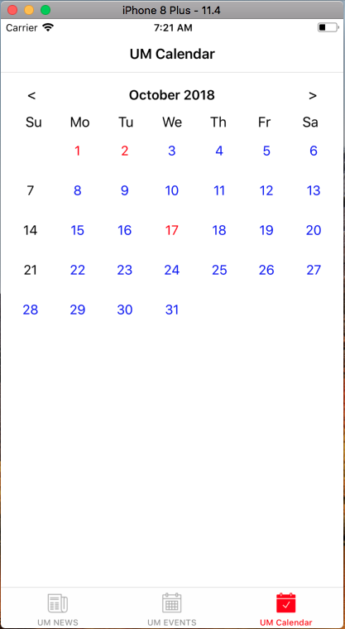

Slide 4

News Interface

Slide 5
News Interface
Most recent 3 news on
top
Expandable search box
News cell (cells are in chronological order)

Slide 6
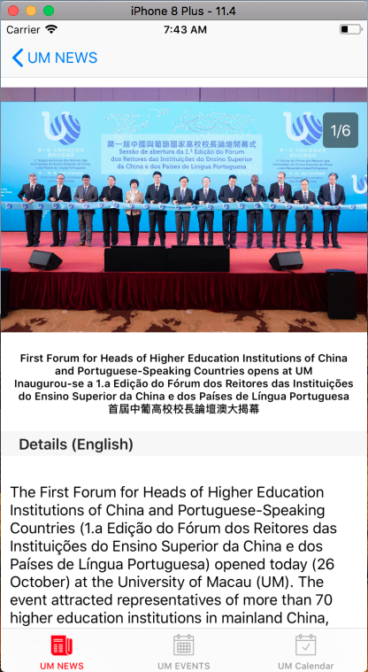
News Detail VIew

Slide 7
News Detail View
All images related to the selected news cell
The title of the news in different languages as provided by the API
Text article related to the selected news cell

Slide 8
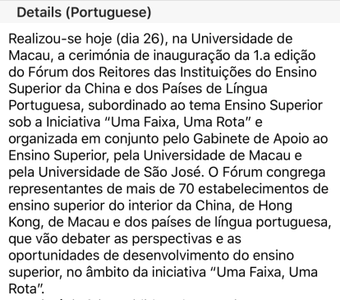
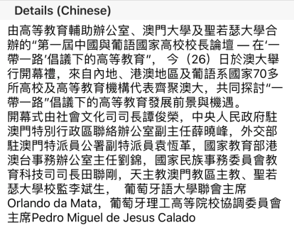
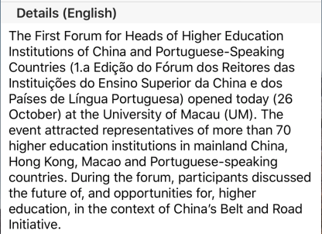
Multiple Languages

Slide 9
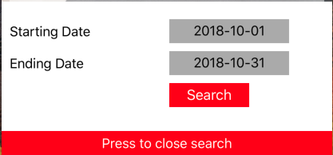
Search function
Search for news on a time range
Collapsible search box

Slide 10
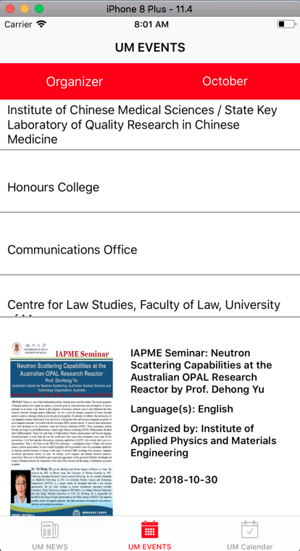
Events interface
Events interface

Slide 11
Events interface
Button to open/close a collapsible menu that allows selection of events created by a certain department (blue highlight)
Month Selection (green highlight)

Slide 12
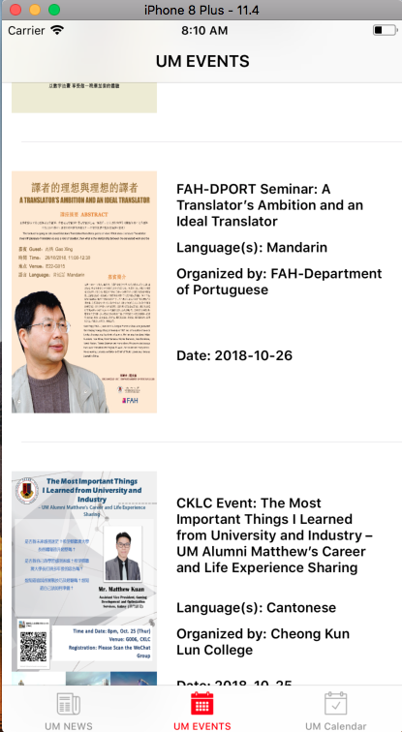
Events interface
Events can be shown for a whole month or organized by a certain department (for the selected month)

Slide 13
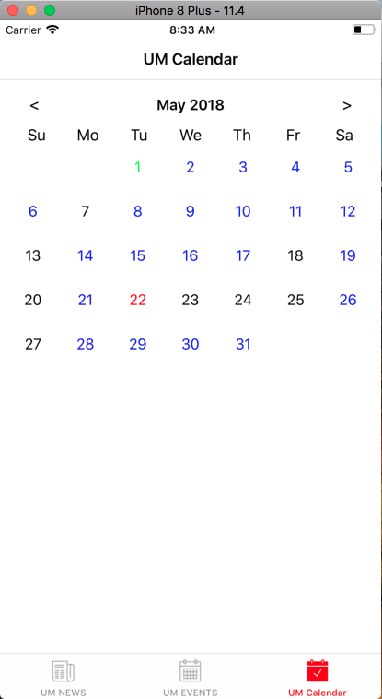
Events calendar
Days in red represent a Public Holiday
Days in blue are days that contain activities
Days in green are days that are holidays and contain activities
Days in black contain neither activities or holidays

Slide 14
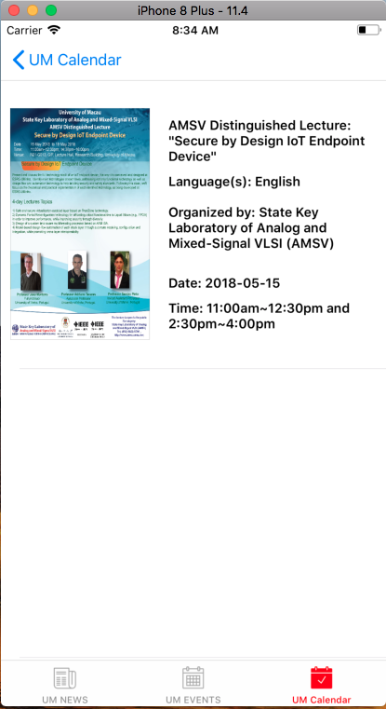
Events calendar

Slide 15
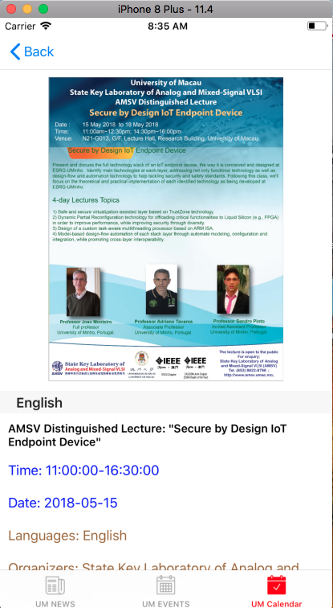
Events calendar
Poster of the selected event – this poster can be expanded when clicked
Activity details in multiple languages as provided by the API

Slide 16
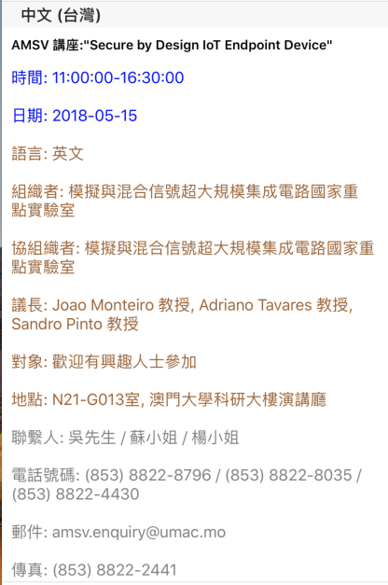
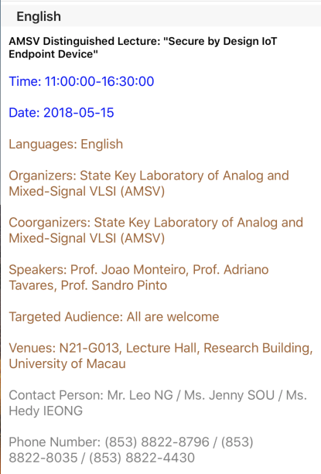
Events calendar

Slide 17
Demo

